Slide 1
WPTA December Representative Council Meeting
Sped Updates/Health and Safety
APPR Resolution
Grievances
Tenure
District Liaison
Surveys Secondary & Elementary
Thank you!
March on the 6th for Tier 6 /Fix Tier 6 & Vote COPE

Slide 2
APPR History

Slide 3
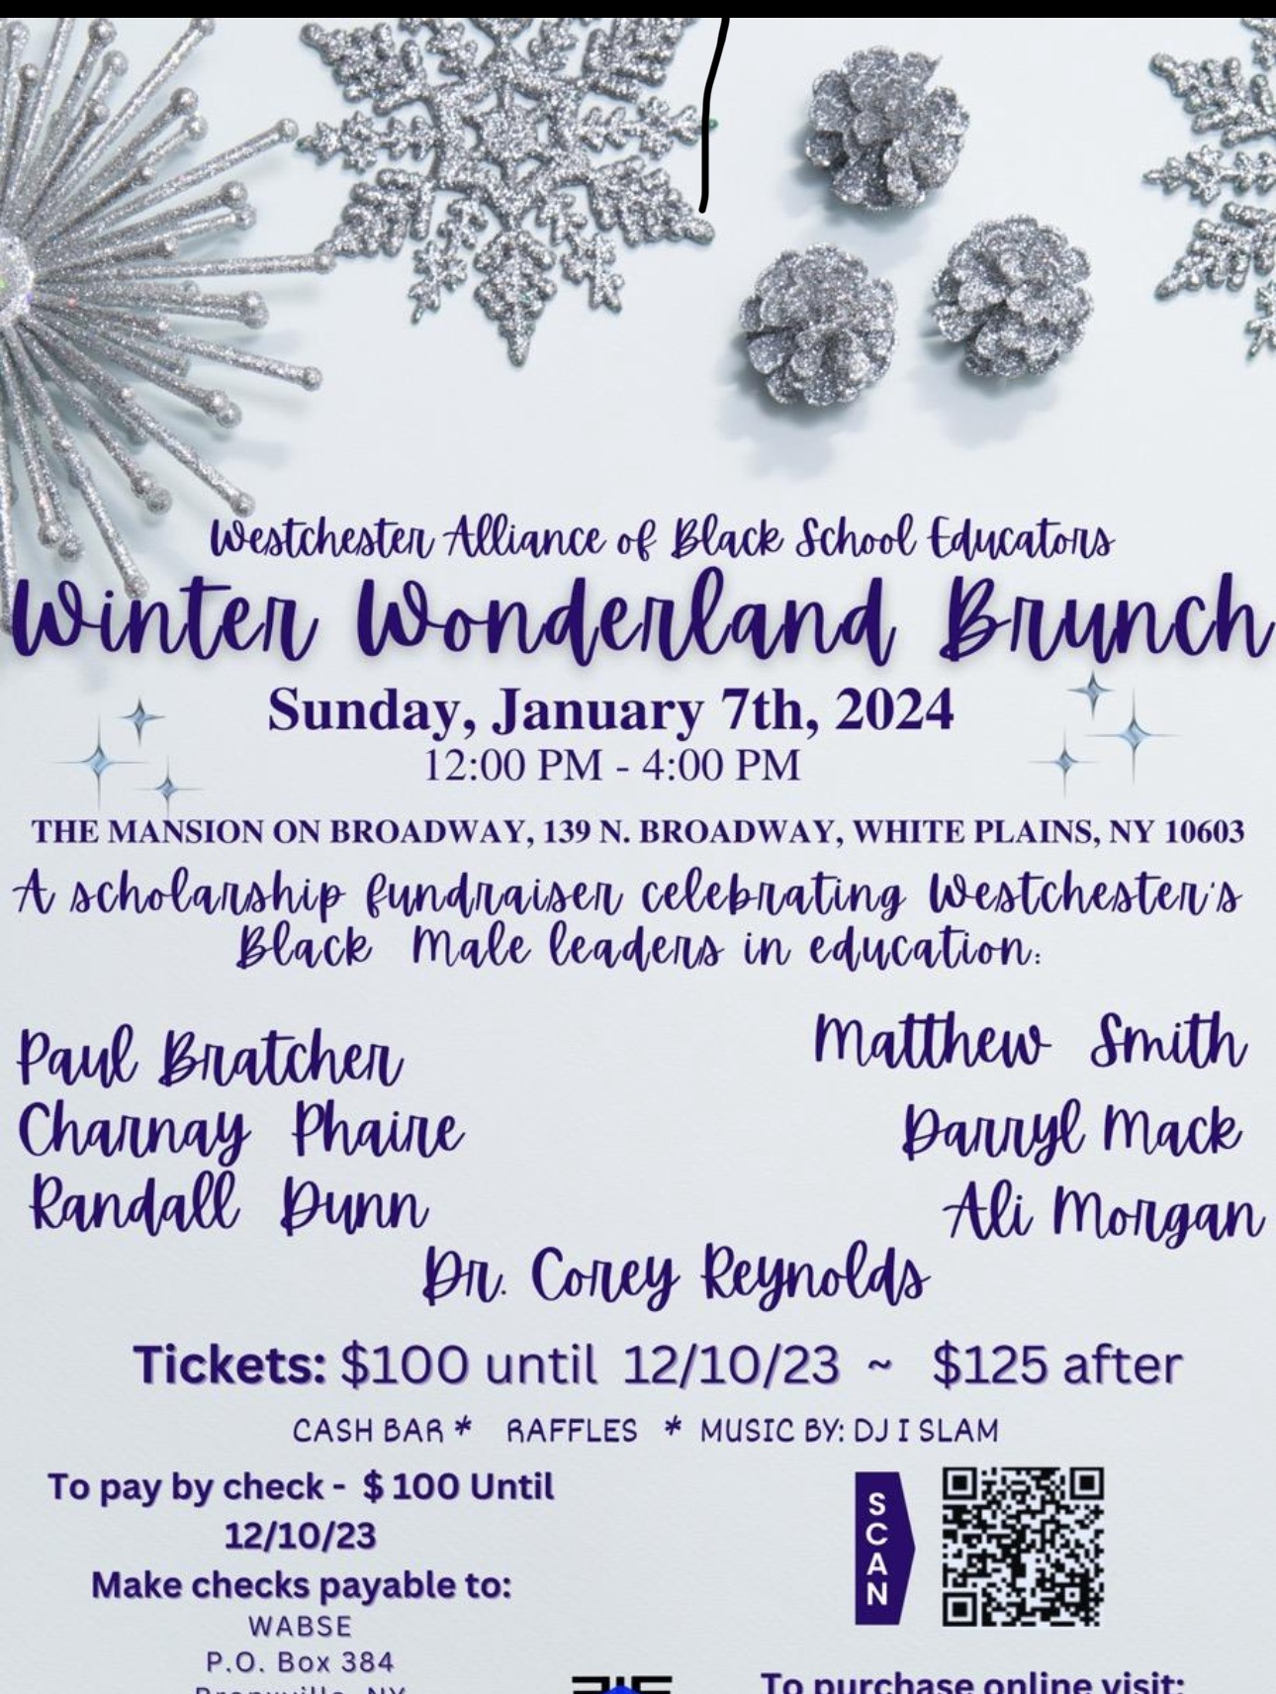
Motions
The WPTA representative council supports using the English Regents and the US History for every member’s APPR score for the 23-24 school year.

Slide 4
Recommended approval of the appointment to tenure of the following:
Amy Torres, School Counselor, Middle School – Eastview, effective 1/5/24
Michelle Bason, School Counselor, High School, effective 1/13/24
Vicky School-Mendez, Elementary Education Teacher, Post Road School, 1/29/24
Luz Arapa, Elementary Education Teacher, Church Street School, effective 11/28/23
Megan Brannigan, Elementary Education Teacher, Ridgeway School, 2/27/24
Marissa Terry, Elementary Education Teacher, Ridgeway School, effective 1/5/24
Robert Peeples, Science, Middle School - Highlands, effective 12/5/23
Kirsten Calkins, LOTE, High School, effective 2/5/24

Slide 5
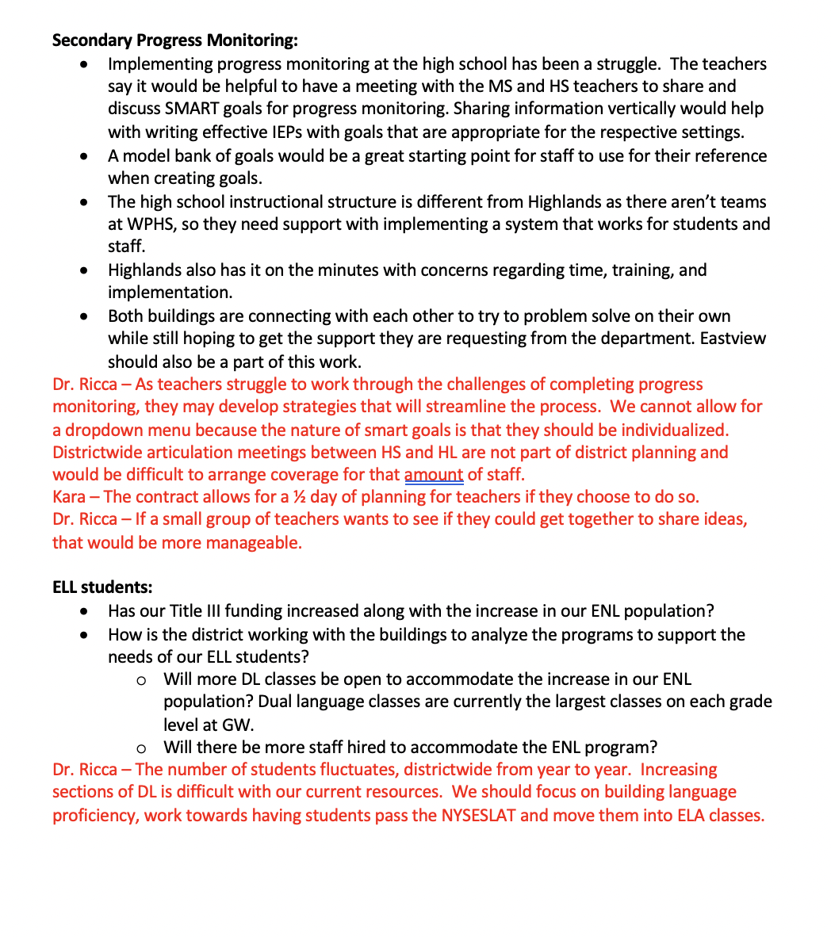
District Liaison

Slide 6
President’s Report
SPED/Health & Safety:The Safety Protocol has made an impact by drawing attention to issues in classrooms. As a result, interventions and program reviews are happening to work towards FAPE and safety for all. Thank you to every single person who took the leap to fill these out. They are making a huge impact. Our safety protocol is now being used by other locals across the state.
APPR: While our state union’s hope is this the year that the NYS legislature will return the APPR to the locals, in order to protect all of our members, the performance part of all of our APPR’s will be tied to the English and History Regents. We are all tied together. Take action to return our APPR to locals by signing up for the NYSUT MAC (MEMBER ACTION CENTER) here. You will receive updates to make your voice heard by our representatives. https://mac.nysut.org/
JANUS: There are still plenty of legal attacks on unions, but the union movement is growing nationwide. AFT has added 80 more units this year. The most recent is the University of Hawaii. We are part of something larger and we continue to fight!

Slide 7
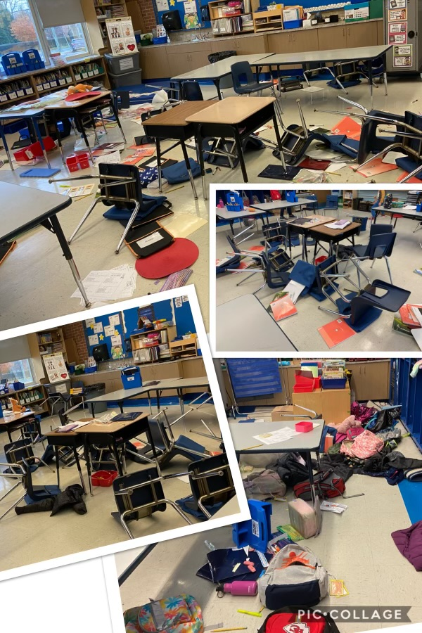
Safety Protocol
In an on-going effort to continuously improve our communication strategies and effectiveness, we will immediately implement the following the protocol below with regard to significant safety/learning environment disruptions.
For the purpose of this effort, a safety concern or learning environment disruption may include, but is not limited to, student challenges/behavioral concerns that force an evacuation and/or student removal from the classroom; an injury to a staff member or student under their supervision; and/or a situation that creates a serious disruption to the learning environment and/or safety of students/staff.
Communication Protocol:
Upon identification of significant educational disruption of the school/classroom environment and/or injury, a faculty/staff member will: provide notification, via email, to the building-level supervisor/principal, the superintendent, the superintendent’s cabinet, the nurse coordinator, and the union presidents.
Documentation of the incident (including photos, if applicable) will be completed by the reporting adult which should include an incident report and a nurse’s report (if necessary) will be forwarded to human resources and the nurse coordinator.
Any stakeholder involved in the reported incident may request support to investigate if further action is necessary to ensure a safe and/or secure learning and work environment which is referenced in both the WPTA contract and the White Plains CSD Code of Conduct.
If appropriate, next steps will be collaboratively determined by the superintendent’s designees and associations’ designees.
Please share this communication requirement with our colleagues at your next faculty and staff meeting. It is our hope that this simple procedure will go along way to making certain that we are all informed of any significant disruptions or safety concerns.

Slide 8
Weingarten Rights
Use representation.

Slide 9
NYSUT Committee meetings
Women's Committee
Kara McCormick-Lyons 914-400-8709
kmclyons@gmail.com
BIPOC Leadership
Najee Barnes (914) 330-7308
najeeebarnes@gmail.com
English Language Learner Committee
Vicki (Maria) Sawyer (562) 900-1665
vickiesawyer@wpcsd.k12.ny.us

Slide 10
Westchester Putnam Labor Council Delegates
Ray Drach
Jen Stein
Angie Garcia
Anthony Russo
Eliseo Lugo
John Hughes

Slide 11
Spotlight
What do you want to highlight in your building?
WPTA coat drive
HL is doing snow flakes

